Slide 1

Resume Screening AI Assistant Project
Automating resume classification and screening
Using advanced ML and NLP techniques
Name - Vansh Kapoor
PRN – 25030242064
Name - Venkat Saiamruta Sanjana Potnuru
PRN – 25030242066
Name - V Vignan
PRN - 25030242069

Slide 2
Project Objective
Build Predictive Model
Automate Screening
Real-time API
Build a predictive model to classify resumes into job roles by analysing skills, experience, education, and keywords. The model should leverage natural language processing (NLP) and machine learning algorithms to accurately map candidate profiles to relevant positions, improving recruitment efficiency, automating screening, and ensuring better role-person fit.
Automate screening to shortlist candidates matching job criteria by using intelligent algorithms that evaluate resumes against predefined requirements such as skills, education, experience, and certifications. This approach reduces manual effort, minimizes bias, accelerates the hiring process, and ensures only the most relevant applicants are forwarded for further evaluation and interviews.
Provide real-time predictions via a REST API by integrating the trained machine learning model into a scalable service that accepts resume data as input and instantly returns the predicted job role. This enables seamless integration with recruitment platforms, HR systems, and career portals, ensuring efficient, automated, and accurate candidate classification.

Slide 3

Dataset and Preprocessing
Dataset Overview
The dataset comprises more than 500 resumes, each containing job roles and relevant skills, providing a comprehensive foundation for predictive modelling. To ensure data quality, missing values must be addressed systematically using imputation or filtering methods. Proper handling prevents bias and improves reliability, ensuring that the model can learn patterns effectively without being influenced by incomplete or inconsistent records.
Beyond cleaning, it is crucial to parse and transform candidate experience ranges into meaningful numeric variables, such as minimum and maximum years of experience, which serve as structured features for the model. Additionally, the skills data must undergo text preprocessing steps like tokenization, lowercasing, and whitespace removal. These refinements standardize inputs, improve feature extraction, and enhance the performance of natural language processing techniques.

Slide 4

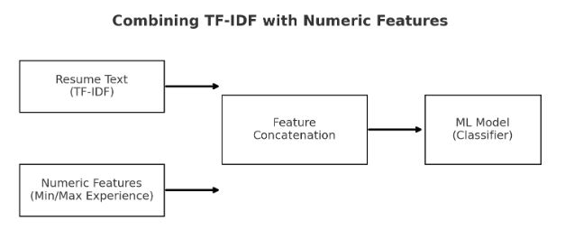
Feature Engineering
01
02
03
TF-IDF Vectorization
Numeric Features
Matrix Combination
TF-IDF vectorization of "Key Skills" (1320 features)
Numeric features: min_exp, max_exp, salary
Combination into sparse matrix for model input
Diagram showing combining TF-IDF with numeric features

Slide 5
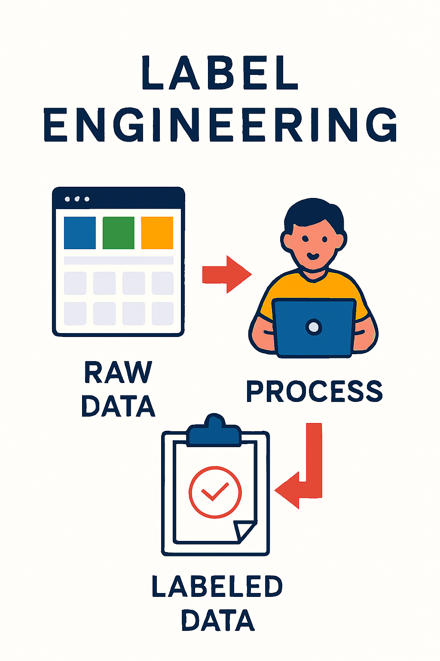
Label Engineering
Class Grouping
To improve model performance, we group infrequent classes into a single, robust "Other" category. This technique reduces data sparsity, as models struggle to learn from rare events, helping to prevent overfitting and improve generalization.
Label Encoding
We convert categorical job role text (e.g., "Software Engineer") into a numerical format using label encoding. Each unique job title is assigned a unique integer (0, 1, 2...). This is a crucial preprocessing step, as supervised classification models require numeric inputs to learn patterns.

Slide 6




Model Building
RandomForest
SMOTE
Hyperparameter Tuning
The class_weight='balanced' parameter in RandomForestClassifier automatically adjusts weights to give more importance to minority classes, combating imbalanced datasets.
SMOTE (Synthetic Minority Over-sampling Technique) creates new, synthetic data points for the minority class based on its nearest neighbours.
GridSearchCV is an optional process that exhaustively tests all specified hyperparameter combinations to find the one yielding the best model performance.

Slide 7

Model Evaluation
Performance Metrics
Metrics: accuracy ~96%, precision, recall, F1-score per class, To assess performance more deeply, we analyse precision, recall, and the F1-score for each class. These metrics are crucial as they reveal how well the model handles each specific category, providing insights that a single accuracy score might obscure, especially with imbalanced data.
For detailed error analysis, a confusion matrix heatmap is an indispensable tool that visually organizes the model's performance by plotting predicted labels against the true labels. The main diagonal represents all correct predictions, where the model's output matched the actual class. Conversely, the off-diagonal cells quantify the errors, with the colour intensity immediately drawing attention to the most frequent misclassifications. This allows us to pinpoint exactly which classes are being confused, guiding targeted improvements to the model.

Slide 8
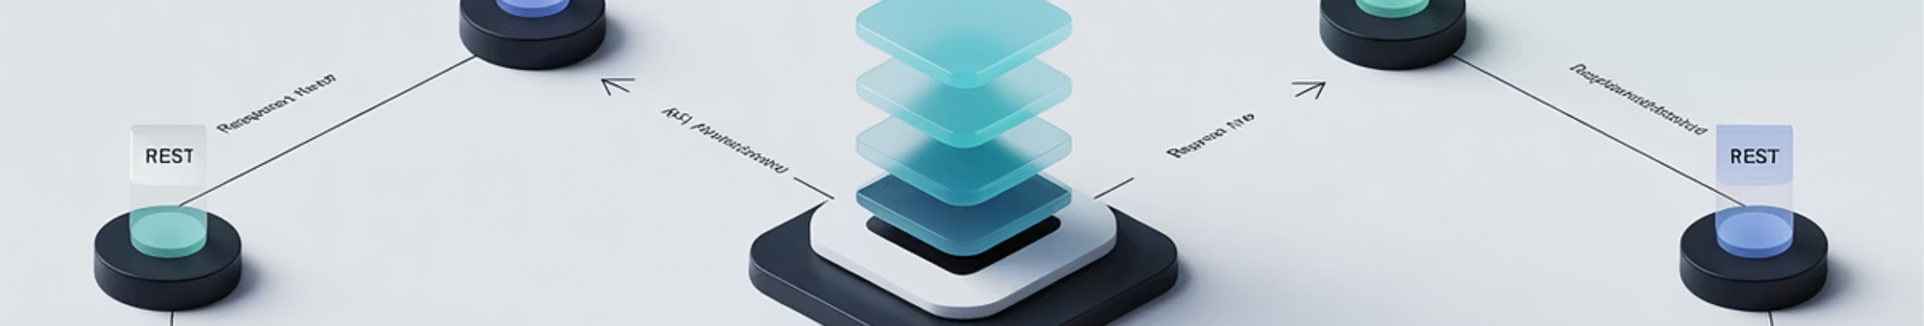



Deployment Architecture
Flask Application
POST Endpoint
API Response
Flask application exposing REST API
POST /predict: input JSON (skills, experience, salary, target_role)
Response: predicted job role and screening decision
Visual: Simple API infrastructure diagram

Slide 9
API Input/Output
Input JSON Example
Output JSON Example
{ "skills": "python, sql, machine learning", "min_exp": 2, "max_exp": 5, "salary": 50000, "target_role": "Data Analyst"}
{ "predicted_role": "Data Analyst", "screened_in": true}

Slide 10
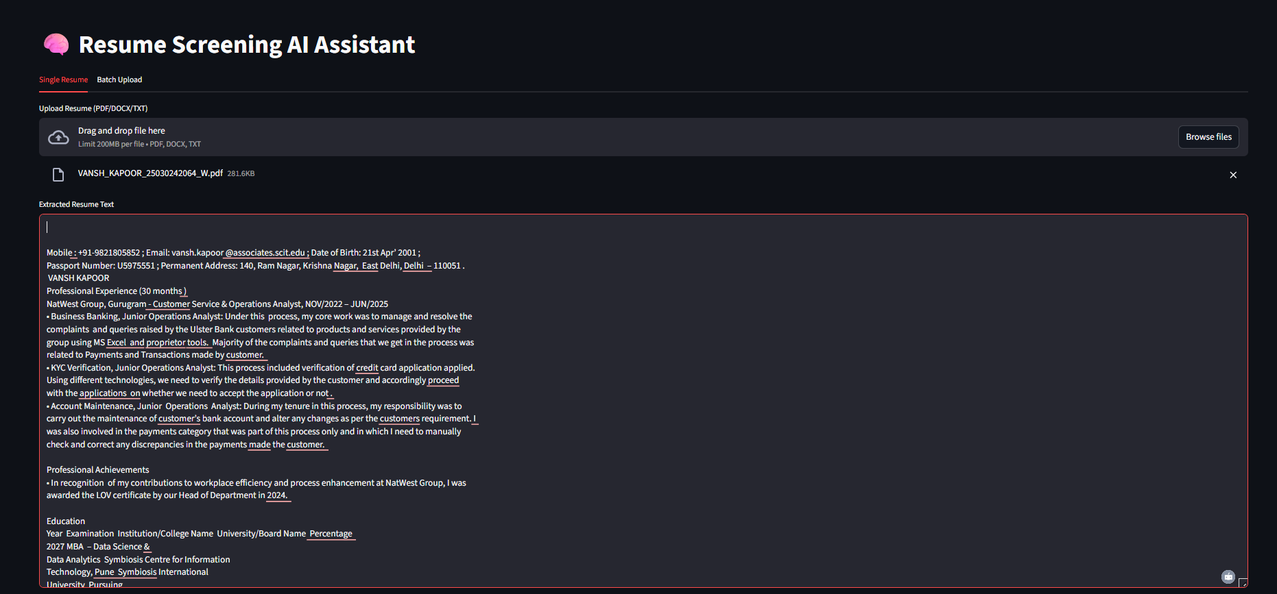
Application Interface
In the Above Snip, we manually uploaded a Resume and basis on that Resume, our model predicted the role as Project Manager

Slide 11
Screening Logic
01
02
03
Role Comparison
Boolean Response
Automated Shortlisting
To rigorously evaluate model performance, we conduct a one-to-one comparison of the predicted role against the actual target role (the ground truth) for every data instance. This fundamental check classifies each prediction as correct or incorrect. These individual outcomes are the raw material of evaluation, which we then aggregate. From this aggregation, we derive critical performance metrics like overall accuracy, as well as class-specific measures such as precision and recall, and visually represent them in a confusion matrix.
This function returns a Boolean value assigned to screened in to represent the outcome of a qualification check. It returns true if the input data successfully meets all the predefined matching criteria, indicating a successful "match." Conversely, it returns false if the criteria are not met. This simple true/false output efficiently signals whether an item should be included for further processing or discarded.
This system enables automated résumé shortlisting, a process that uses technology to streamline the initial hiring phase. Instead of manual screening, the software automatically parses and analyses résumés, comparing candidate qualifications like skills and experience against the specific requirements of the job description. This automated shortlisting process rapidly identifies and ranks the most promising applicants, presenting recruiters with a manageable list of top-tier candidates and saving significant time and manual effort.

Slide 12





Libraries & Tools
Python Ecosystem
NLP Processing
API Backend
Python ecosystem: pandas, numpy, scikit-learn, imblearn, tensorflow
NLP with transformers BERT embeddings
Streamlit for REST API backend
Model Persistence
API Testing
Joblib for model persistence
NGROK for Authentication Key

Slide 13
Platform Details
Development Environment
Deployment Environment
Local Jupyter notebook for development & training
Flask app running on local/server environment for deployment
Testing Tools
Cloud Options
Postman for API testing
Optional cloud deployment on AWS/GCP/Heroku

Slide 14




Benefits
Process Efficiency
Time Savings
Streamlines recruitment process
Saves recruiter time by automated initial screening
Consistent Filtering
Scalability
Consistent, unbiased candidate filtering
Scalable with additional data & roles

Slide 15




Future Scope
Hierarchical Classification
Deep Embeddings
Add multi-stage hierarchical classification
Incorporate deep embeddings (BERT, etc.) for better feature representation
Cloud Deployment
User Interface
Cloud deployment with authentication & monitoring
UI for bulk upload and report generation

